Slide 1

Green Pace
Security Policy Presentation
Developer: Beth Campbell
[Complete this template by replacing the bracketed text with the relevant information.]

Slide 2

OVERVIEW: DEFENSE IN DEPTH
The Green Pace Security policy:
Coding Standards
Risk Assessment
Automated Detection

Slide 3
THREATS MATRIX
Likely Never qualify a reference type with const or volatile Do not cast to an out-of-range enumeration value Guarantee that storage for strings has sufficient space for character data and the null terminator Do not alternately input and output from a file stream without an intervening positioning call Name of Standard Properly deallocate dynamically allocated resources | Priority Do not cast to an out-of-range enumeration value Name of Standard Properly deallocate dynamically allocated resources Handle all exceptions. Do not delete a polymorphic object without a virtual destructor. Use valid references, pointers, and iterators to reference elements of a container
Low priority Incorporate diagnostic tests using assertions | Unlikely Handle all exceptions. Do not delete a polymorphic object without a virtual destructor. Use valid references, pointers, and iterators to reference elements of a container Guarantee that library functions do not overflow

Slide 4
10 PRINCIPLES
Validate Input Data
Guarantee that storage for strings has sufficient space for character data and the null terminator.
Heed Compiler Warnings
Never qualify a reference type with const or volatile.
Architect and Design for Security Policies
Do not cast to an out-of-range enumeration value.
Use valid references, pointers, and iterators to reference elements of a container.
Guarantee that library functions do not overflow.
Keep It Simple
Do not alternately input and output from a file stream without an intervening positioning call.
Default Deny
Adhere to the Principle of Least Privilege
Properly deallocate dynamically allocated resources.
Handle all exceptions.
Do not delete a polymorphic object without a virtual destructor.
Sanitize Data Sent to Other Systems
Practice Defense in Depth
Guarantee that storage for strings has sufficient space for character data and the null terminator.
Incorporate diagnostic tests using assertions.
Use Effective Quality Assurance Techniques
Incorporate diagnostic tests using assertions.
Adopts a Secure Coding Standard
Guarantee that library functions do not overflow.

Slide 5
CODING STANDARDS
Never qualify a reference type with const or volatile
Do not cast to an out-of-range enumeration value
Guarantee that storage for strings has sufficient space for character data and the null terminator
Do not alternately input and output from a file stream without an intervening positioning call
Properly deallocate dynamically allocated resources
Incorporate diagnostic tests using assertions
Handle all exceptions
Do not delete a polymorphic object without a virtual destructor
Use valid references, pointers, and iterators to reference elements of a container
Guarantee that library functions do not overflow

Slide 6
ENCRYPTION POLICIES
Encryption at rest involves securing data when it is stored in databases, file systems, or other storage devices.
Encryption in flight secures the data while being transmitted over networks.
Encryption in use protects data while it is being processed or used by applications.

Slide 7
TRIPLE-A POLICIES
Authentication Policy- Only authorized entities may gain access to sensitive information.
Authorization Policy – Users can only access resources relevant to their roles and responsibilities.
Accounting Policy- Logging and monitoring mechanisms can detect and respond to malicious or suspicious activities.

Slide 8
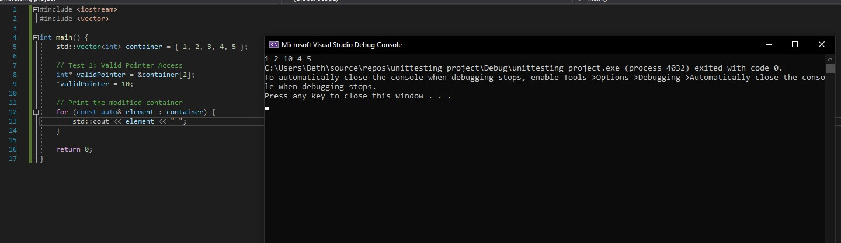
Use valid references, pointers, and iterators to reference elements of a container. Will the code correctly use a valid pointer to access and modify an element within the container?

Slide 9
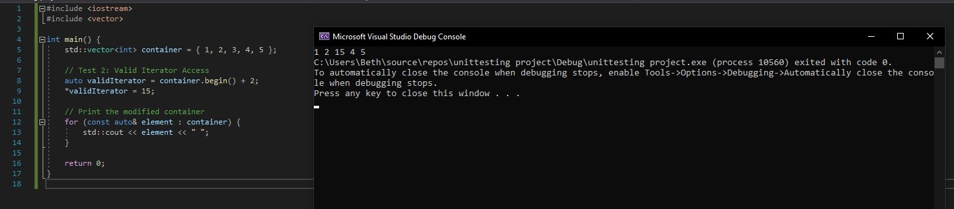
Use valid references, pointers, and iterators to reference elements of a container. Will the code appropriately employ a valid iterator to access and modify an element within the container?

Slide 10
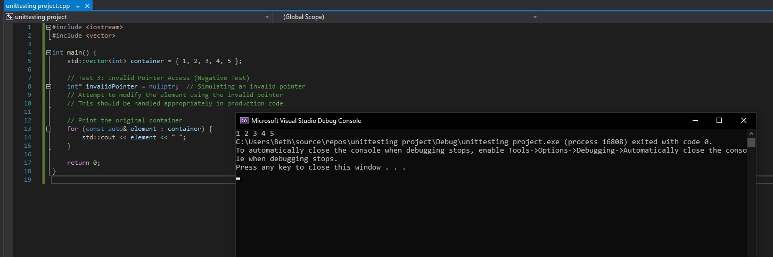
Use valid references, pointers, and iterators to reference elements of a container. Will the code handle invalid pointers gracefully and prevent unauthorized access?

Slide 11
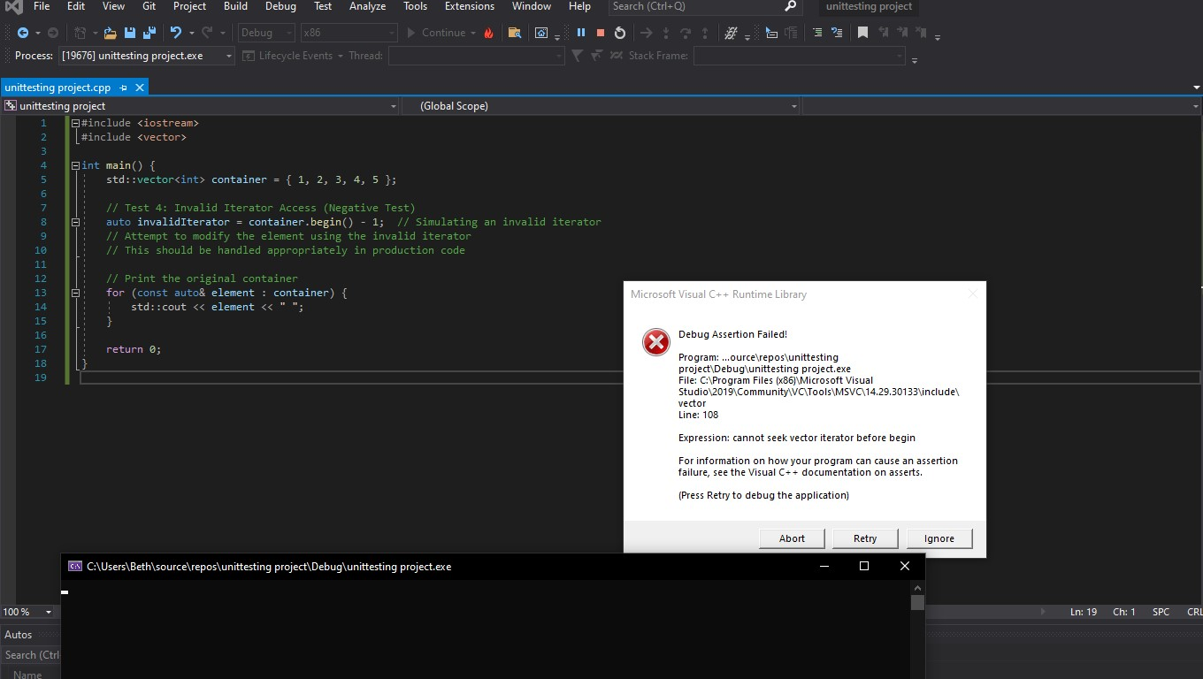
Use valid references, pointers, and iterators to reference elements of a container. Will the code manage invalid iterators to prevent unauthorized access?

Slide 12

AUTOMATION SUMMARY

Slide 13
TOOLS
The DevOps Pipeline is integrates security practices at every stage of the software development lifecycle. This aims to ensure that security is an integral part of the development process.
During coding, Clang Static Analyzer, Cppcheck, Coverity, PVS Studio are used for static code analysis and Google Test for unit testing.
During the Building phase, CppDepend is used for code quality and maintenance. Valgrind would be used for memory debugging.
Testing is used OCLint for static code analysis and Static Analysis Security testing is used for security testing.
Integration will require FindBugs to identify software bugs.
Deployment will use SonarSource for continuous inspection of code quality and CheckMarx for security testing.
During the Monitoring phase, PMD will be used for source code analysis.

Slide 14
RISKS AND BENEFITS
The current security strategy faces challenges in addressing potential coding vulnerabilities. The absence of checks and measures may lead to unintended access or modification of elements.
Implementing secure testing and validation mechanisms will decrease the risk of security threats succeeding. Testing such as Clang Static Analyzer, Google Test and Cppcheck will proactively identify and rectify issues. Thorough documentation and regular code reviews will also strengthen against potential vulnerabilities.
Delays in addressing these issues may expose the system to unintended data modifications, data leaks, and unexpected behaviors. Addressing the issues promptly preemptively mitigates potential vulnerabilities.

Slide 15
RECOMMENDATIONS
Inadequate Insider Threat Mitigation.
Undefined Incident Response Procedures.
Emerging Technologies and Policies.

Slide 16
CONCLUSIONS
Adherence to latest industry secure coding standards.
Security policy.
Continuous security training.
Staying up to date with advancements in security and technology.

Slide 17
REFERENCES
[Provide APA-style references with links to resources, articles, and videos that you used in your presentation.]

